Slide 1


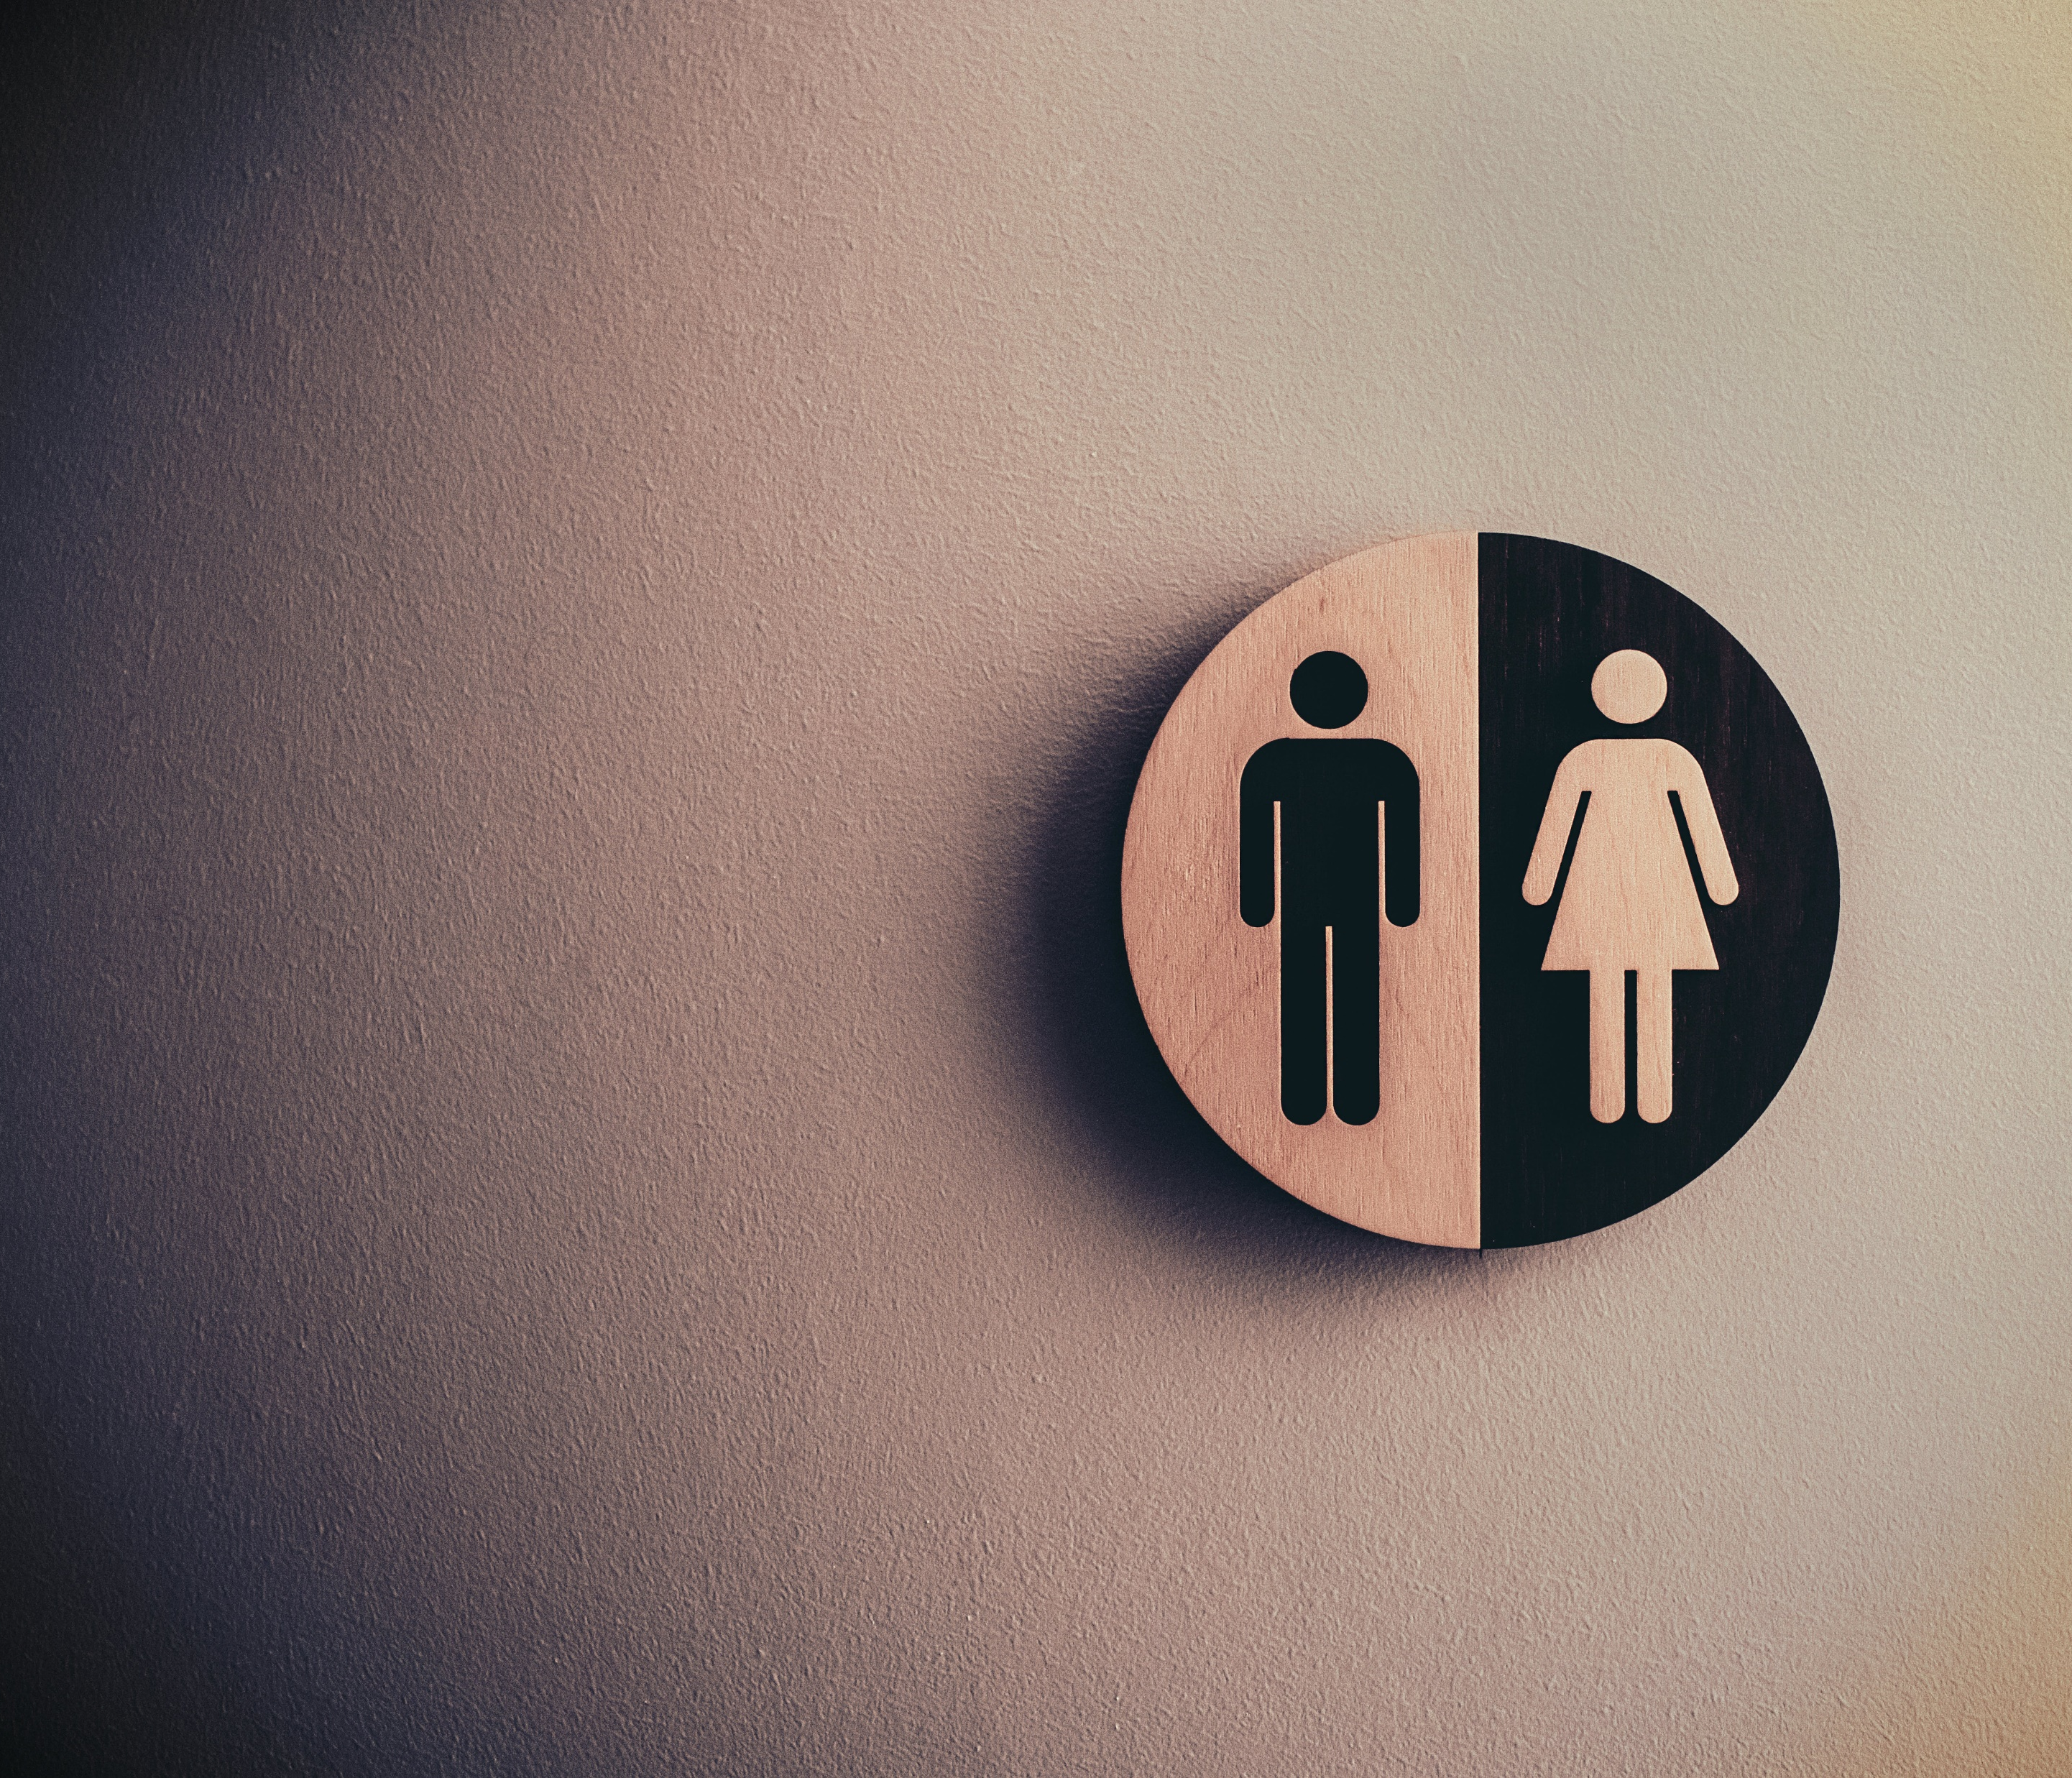





Gender
Detection
API
Gender Detection
Website
Train Model
Get Result
Save the Best Model
Use it
Gender Detection
Website and API
Dataset Preprocessing
For
YOLO v8 Model
Presented
By
Hasan Bin Jamal
Male Female
Gender Detection
Website and API

Slide 2

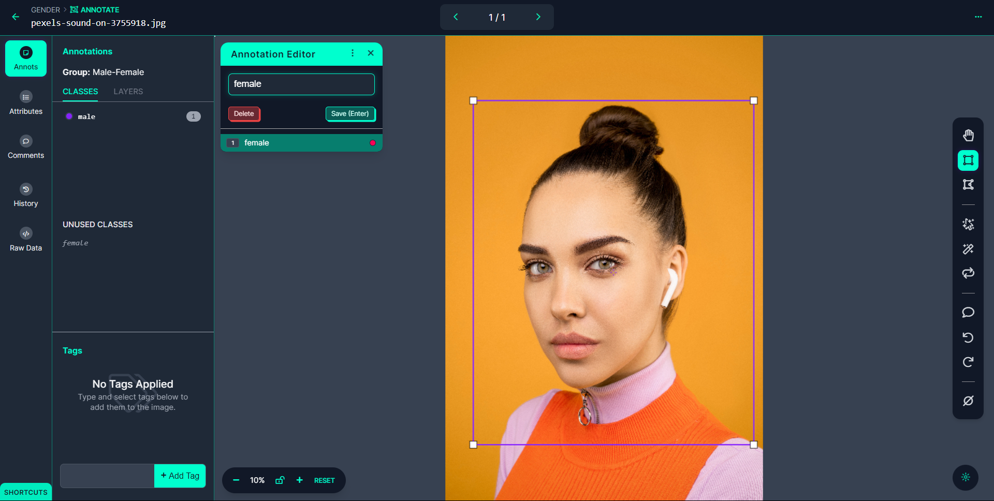

Male Female
Gender Detection
Website and API
Gender
Detection
API
Dataset Preprocessing
Gender Detection
Website
Steps:
Select Images
Upload Images
Annotate Objects
Create Dataset
Export Dataset
Train Model
Get Result
Save the Best Model
Use it
Dataset
Preprocessing
For
Yolo v8 Model

Slide 3
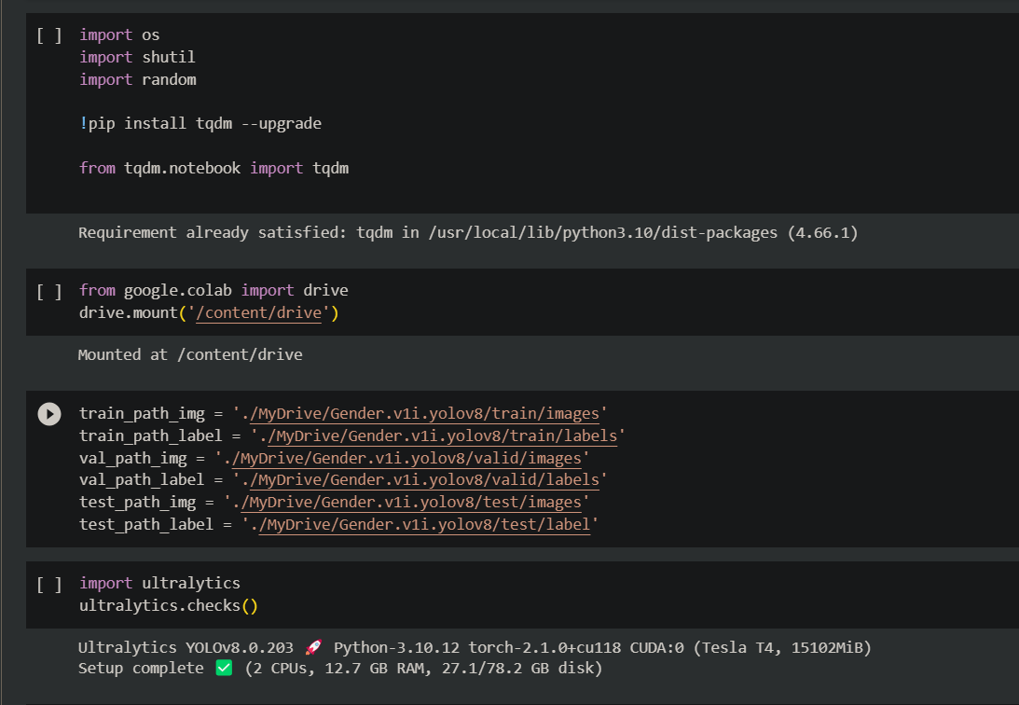

Dataset
Preprocessing
For
YOLOv8 Model
Male Female
Gender Detection
Website and API
Model Training
Gender
Detection
API
Steps:
Install Libraires
Upload Dataset
Connect Drive
Train Model
Get Result
Save Preferred Model
Gender Detection
Website
Train Model
Get Result
Save Best Model
Use It

Slide 4
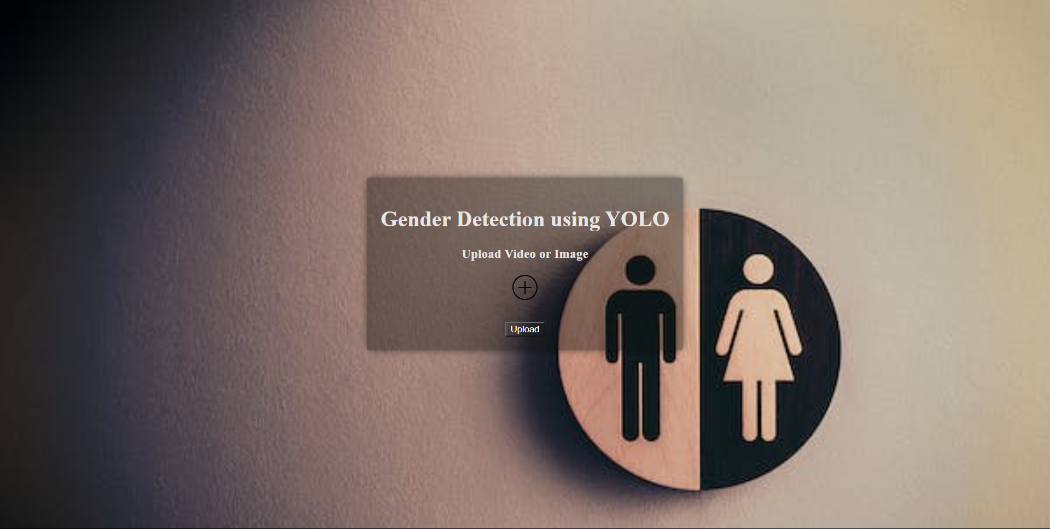

Train Model
Get Result
Save the best Model
Use it
Dataset
Preprocessing
For
YOLOv8 Model
Website
Male Female
Gender Detection
Website and API
Gender
Detection
API
Gender Detection
Website

Slide 5
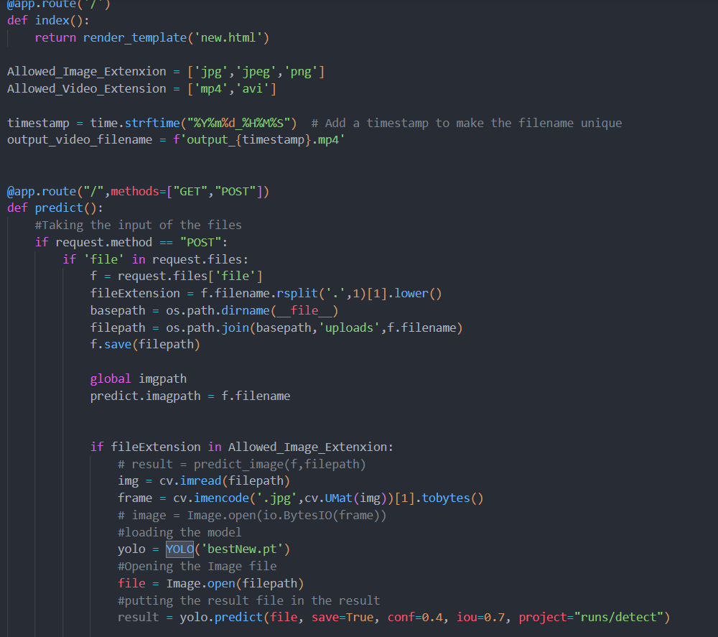
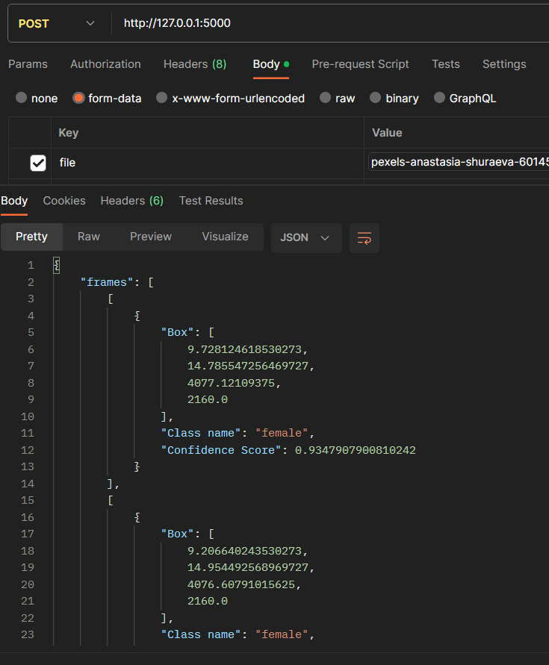

Gender Detection
Website
Train Model
Get Result
Save the best Model
Use it
API
Dataset
Preprocessing
For
YOLOv8 Model
Male Female
Gender Detection
Website and API
Gender
Detection

Slide 6
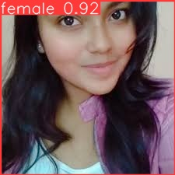
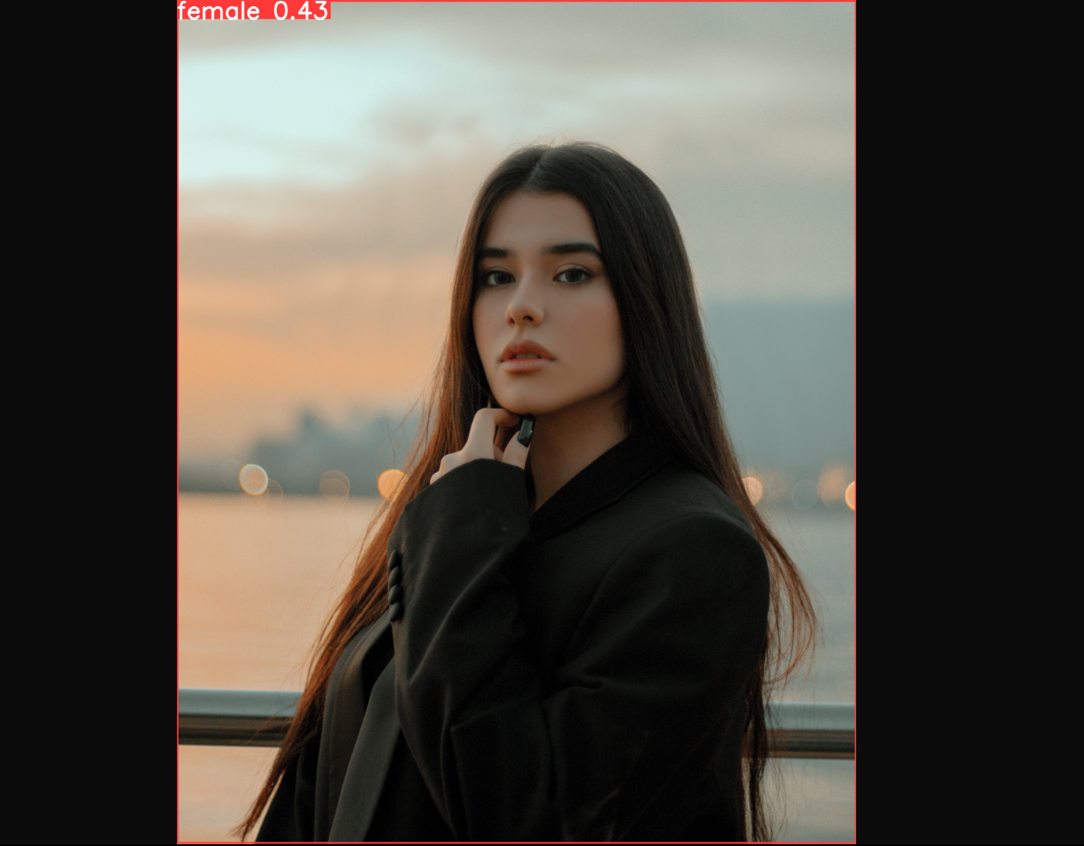


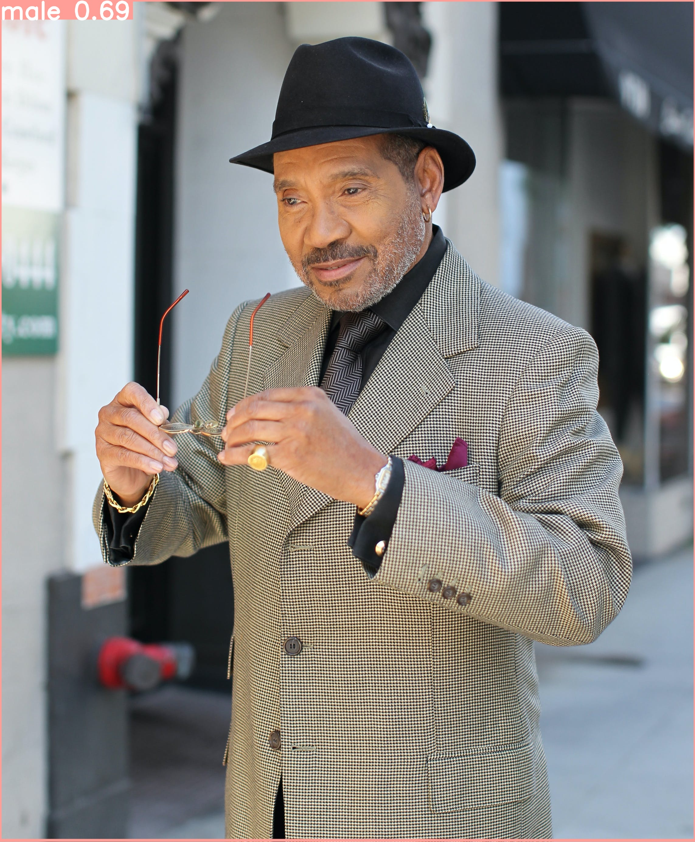
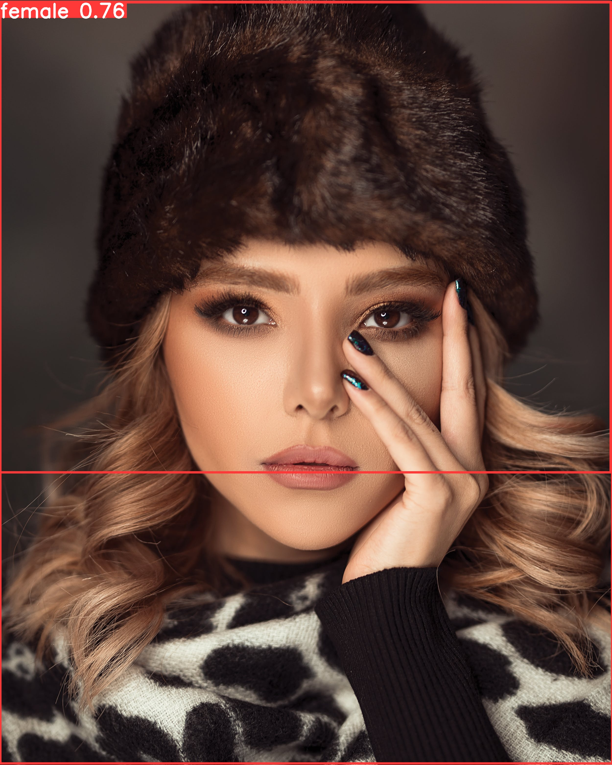
Results

Slide 7
THANK YOU

